Slide 1
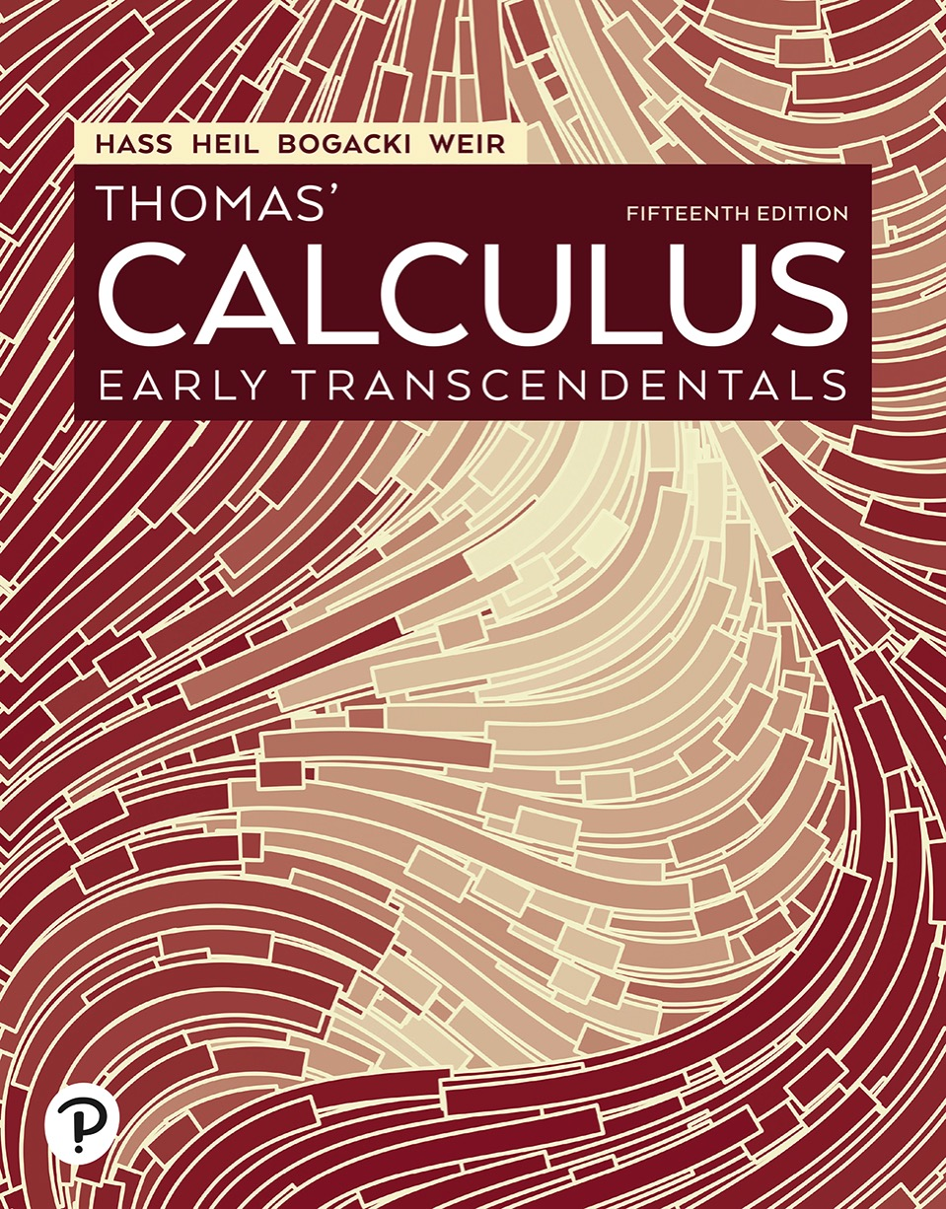

Thomas’ Calculus: Early Transcendentals
Fifteenth Edition
Chapter 14
Partial Derivatives
Copyright © 2023, 2018, 2014 Pearson Education, Inc. All Rights Reserved
Notes:
If this PowerPoint presentation contains mathematical equations, you may need to check that your computer has the following installed:
1) MathType Plugin
2) Math Player (free versions available)
3) NVDA Reader (free versions available)

Slide 2
Section 14.1 Functions of Several Variables

Slide 3
Functions of Several Variables (1 of 2)
Definitions: Suppose D is a set of n-tuples of real numbers
A real-valued function f on D is a rule that
assigns a unique (single) real number
to each element in D. The set D is the function’s domain. The set of w-values taken on by f is the function’s range. The symbol w is the dependent variable of f, and f is said
to be a function of the n independent variables
We also call the
the function’s input variables and
call w the function’s output variable.

Slide 4
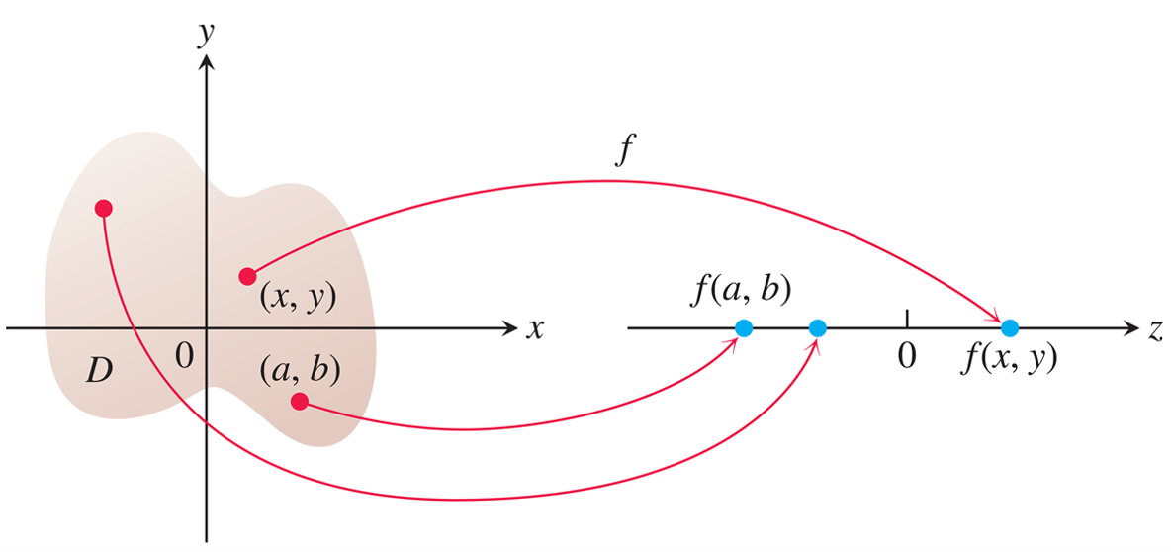
Functions of Several Variables (2 of 2)
An arrow diagram for the function
Notes:
The x y plane has an irregular domain, D, which encloses a point marked in the second quadrant, a point (x, y) in the first quadrant, and a point (a, b) in the fourth quadrant. An arrow, f, from (x, y) points toward point f of x and y on the z axis. An arrow from (a, b) points toward point f of a and b on the z axis. An arrow from the point marked in the second quadrant points toward a point that is between point f of a and b and 0 on the z axis.

Slide 5
Domains and Ranges (1 of 2)
Example:
(a) These are functions of two variables. Note the restrictions that may apply to their domains in order to obtain a real value for the dependent variable z.
Function | Domain | Range
z = square root of start expression y minus x squared end expression | y is greater than or equal to x squared | Left bracket 0, infinity right parenthesis.
z = start fraction 1 over x y end fraction | x y does not equal 0 | Union of left parenthesis negative infinity, 0 right parenthesis and left parenthesis 0, infinity right parenthesis.
z = sine of x y | Entire plane | Left bracket negative 1, 1 right bracket.

Slide 6
Domains and Ranges (2 of 2)
Example (concluded):
(b) These are functions of three variables with restrictions on some of their domains.
Function | Domain | Range
w = square root of start expression x squared + y squared + z squared end expression | Entire space | Entire space, Left bracket 0, infinity right parenthesis
w = start fraction 1 over x squared + y squared + z squared end fraction | left parenthesis x, y, z right parenthesis does not equal left parenthesis 0, 0, 0 right parenthesis | Left parenthesis 0, infinity right parenthesis.
w = x y natural log of z | Half space z is greater than 0 | Left parenthesis negative infinity, infinity right parenthesis.

Slide 7
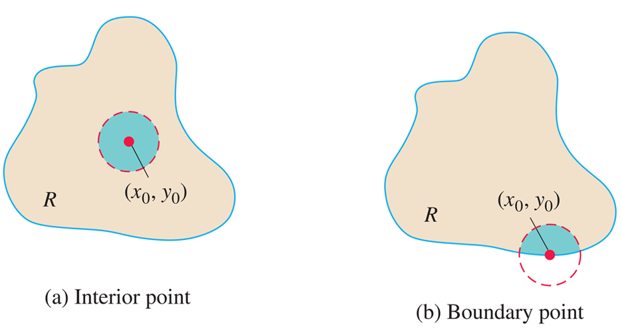
Functions of Two Variables (1 of 6)
Interior points and boundary points of a plane region R. An interior point is necessarily a point of R. A boundary point of R need not belong to R.
Notes:
A circle is drawn with dashed lines inside the region R. The center of the circle is (x sub 0, y sub 0). The second irregular region R is labeled, boundary point. A circle is drawn with dashed lines on the boundary line of the second irregular region R. The center of the circle is (x sub 0, y sub 0), which lies on the boundary line of R.

Slide 8
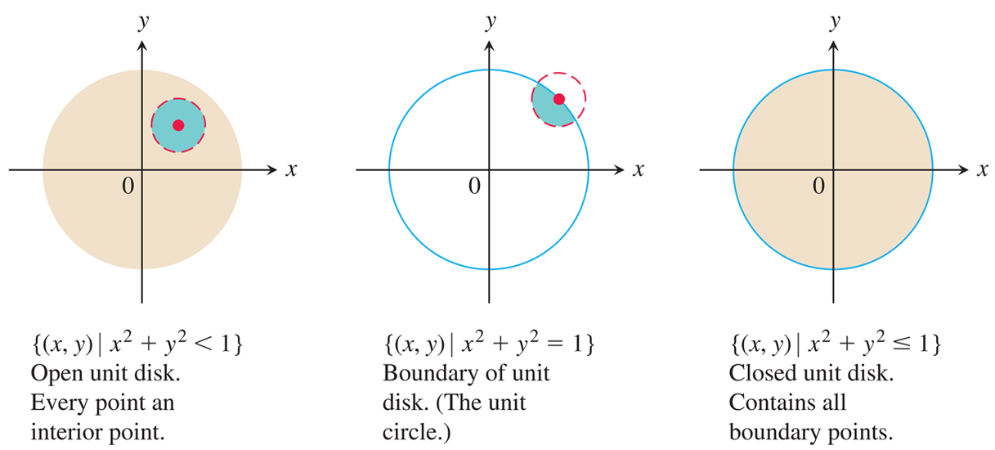
Functions of Two Variables (2 of 6)
Interior points and boundary points of the unit disk in the plane.
Notes:
The first x y plane depicts a shaded circle without a boundary line. The circle has its center at the origin. A small circle is drawn with dashed lines in the first quadrant. The text denoting the graph reads, left brace left parenthesis x, y right parenthesis vertical bar x squared + y squared is less than 1 right brace. Open unit disk. Every point an interior point. The second x y plane depicts a circle with a boundary line. The circle has its center at the origin. A small circle is drawn with dashed lines in the first quadrant, with its center lying on the boundary of the circle. The text denoting the graph reads, left brace left parenthesis x, y right parenthesis vertical bar x squared + y squared = 1 right brace. Boundary of unit disk. The unit circle. The third x y plane depicts a shaded circle with a boundary line. The circle has its center at the origin. The text denoting the graph reads, left brace left parenthesis x, y right parenthesis vertical bar x squared + y squared is less than or equal to 1 right brace. Closed unit disk. Contains all boundary points.

Slide 9
Functions of Two Variables (3 of 6)
Definitions: A point
in a region (set) R in the
x y-plane is an interior point of R if it is the center of a disk
of positive radius that lies entirely in R. A point
is a boundary point of R if every disk centered at
contains points that lie outside of R as well as points that lie in R. (The boundary point itself need not belong to R.)
The interior points of a region, as a set, make up the interior of the region. The region’s boundary points make up its boundary. A region is open if it consists entirely of interior points. A region is closed if it contains all its boundary points.

Slide 10
Functions of Two Variables (4 of 6)
Definitions: A region in the plane is bounded if it lies inside a disk of finite radius. A region is unbounded if it is not bounded.

Slide 11
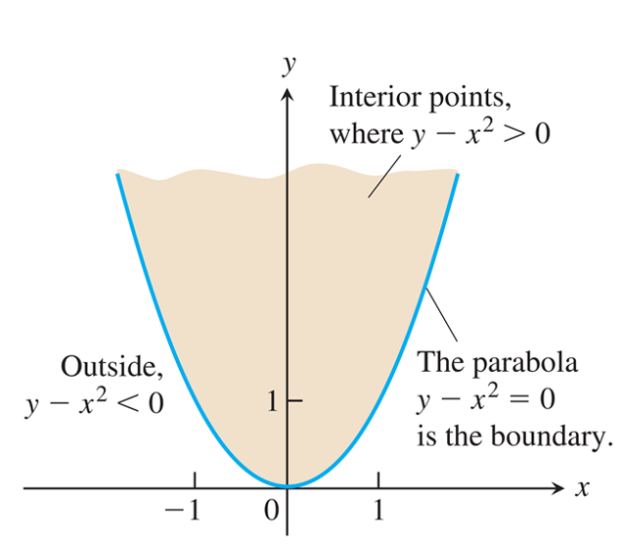
Functions of Two Variables (5 of 6)
The domain of
consists of the shaded
region and its bounding parabola.
Notes:
The parabola passes through (negative 1, 1), (0, 0), and (1, 1). The region that lies within the parabola is shaded. The shaded region is labeled, interior points, where y minus x squared is greater than 0. The right portion of the parabola in the first quadrant is labeled, the parabola y minus x squared = 0 is the boundary. The left portion of the parabola in the second quadrant is labeled, outside, y minus x squared is less than 0.

Slide 12
Functions of Two Variables (6 of 6)
Example: Describe the domain of the function
Solution: Since f is defined only where
the domain is the closed, unbounded region. The
parabola
is the boundary of the domain.
The points above the parabola make up the domain’s interior.

Slide 13
Graphs, Level Curves, and Contours of Functions of Two Variables (1 of 5)
Definitions: The set of points in the plane where
a function
has a constant value
is called a level curve of f. The set of all points
in space, for (x, y) in the domain of f,
is called the graph of f. The graph of f is also called
the surface

Slide 14
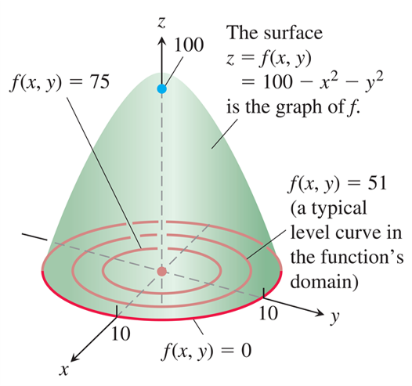
Graphs, Level Curves, and Contours of Functions of Two Variables (2 of 5)
The graph and selected level curves of the function
The level curves lie in the x y-plane, which
is the domain of the function
Notes:
Three level curves are drawn at the base of the paraboloid. The paraboloid is labeled, the surface z = f of x and y = 100 minus x squared minus y squared is the graph of f. The first and outermost level curve is labeled, f of x and y = 0. The second level curve is labeled, f of x and y = 51, a typical level curve in the function’s domain. The third and innermost level curve is labeled, f of x and y = 75.

Slide 15
Graphs, Level Curves, and Contours of Functions of Two Variables (3 of 5)
Example: Graph
and plot the level
curves
in the domain
of f in the plane.
Solution: The domain of f is the entire x y-plane, and the range of f is the set of real numbers less than or equal to
100. The graph is the paraboloid
The level curve
is the set of points in the
x y-plane at which

Slide 16
Graphs, Level Curves, and Contours of Functions of Two Variables (4 of 5)
Solution (continued):
which is the circle of radius 10 centered at the origin.
Similarly, the level curves
are the circles
The level curve
consists of the origin alone.
(It is still a level curve.)

Slide 17
Graphs, Level Curves, and Contours of Functions of Two Variables (5 of 5)
Solution (concluded):
If
then the values of
are negative.
For example, the circle
which is the circle
centered at the origin with radius 12, gives the constant value
and is a level curve of f.

Slide 18
Functions of Three Variables (1 of 6)
Definition: The set of points (x, y, z) in space where a function of three independent variables
has a constant value
is called a
level surface of f.

Slide 19
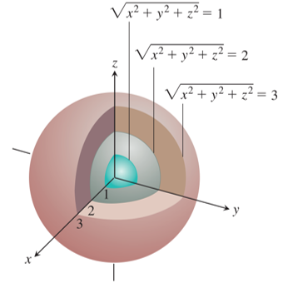
Functions of Three Variables (2 of 6)
The level surfaces of
are concentric spheres.
Notes:
The outermost surface is labeled, the square root of start expression x squared + y squared + z squared end expression = 3. The second surface is labeled, the square root of start expression x squared + y squared + z squared end expression = 2. The innermost surface is labeled, the square root of start expression x squared + y squared + z squared end expression = 1.

Slide 20
Functions of Three Variables (3 of 6)
Example: Describe the level surfaces of the function
Solution: The value of f is the distance from the origin to the point (x, y, z). Each level surface
is a sphere of radius c
centered at the origin. The level surface
consists of the origin alone.

Slide 21
Functions of Three Variables (4 of 6)
Solution (concluded):
The level surfaces show how the function’s values change as we move through its domain. If we remain on a sphere of radius c centered at the origin, the function maintains a constant value, namely c. If we move from a point on one sphere to a point on another, the function’s value changes. It increases if we move away from the origin and decreases if we move toward the origin.

Slide 22
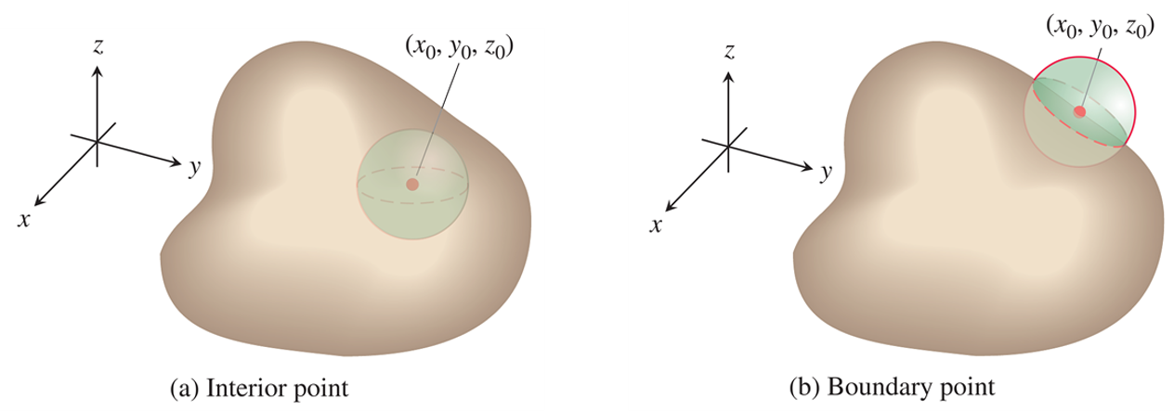
Functions of Three Variables (5 of 6)
Interior points and boundary points of a region in space. As with regions in the plane, a boundary point need not belong to the space region R.
Notes:
The first illustration depicts a solid ball inside an irregular region. The center of the solid ball is (x sub 0, y sub 0, z sub 0). The second illustration depicts an irregular region. Half portion of a solid ball lies inside the irregular region. The center of the solid ball is (x sub 0, y sub 0, z sub 0).

Slide 23
Functions of Three Variables (6 of 6)
Definitions: A point
in a region R in space is an
interior point of R if it is the center of a solid ball that lies
entirely in R. A point
is a boundary point of R
if every solid ball centered at
contains points that
lie outside of R as well as points that lie inside R. The interior of R is the set of interior points of R. The boundary of R is the set of boundary points of R.
A region is open if it consists entirely of interior points. A region is closed if it contains its entire boundary.

Slide 24
Section 14.2 Limits and Continuity in Higher Dimensions

Slide 25
Limits for Functions of Two Variables (1 of 10)
Definition: We say that a function
approaches
the limit L as (x, y) approaches
and write
if, for every number
there exists a corresponding
number
such that for all (x, y) in the domain of f,

Slide 26
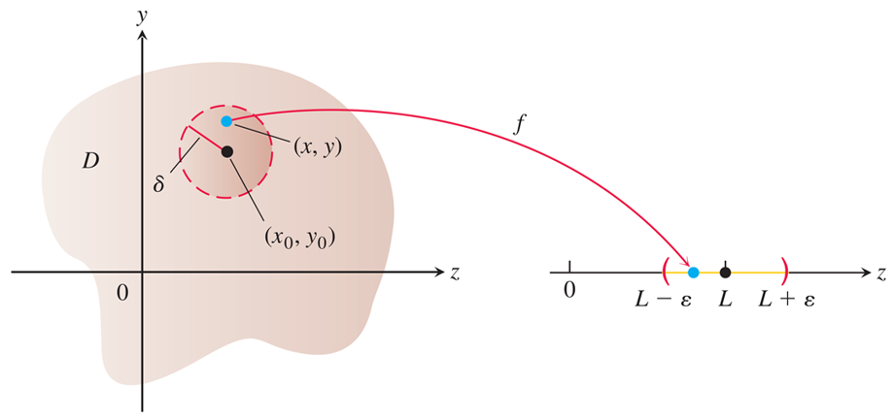
Limits for Functions of Two Variables (2 of 10)
In the limit definition,
is the radius of a disk centered at
For all points (x, y) within this disk, the function
values
lie inside the corresponding interval
Notes:
A circle is drawn with dashed lines inside an irregular domain D, which lies in the y z plane. The center of the circle is (x sub 0, y sub 0) and radius is delta. Point (x, y) lies inside the circle. Three points, L minus epsilon, L, and L + epsilon, are marked on the separate z axis. The points, L minus epsilon and L + epsilon, are marked with a left parenthesis and a right parenthesis, respectively. An arrow labeled, f, starts from (x, y) in the y z plane to a point that lies between L minus epsilon and L, on the z axis.

Slide 27
Limits for Functions of Two Variables (3 of 10)
Theorem—Properties of Limits of Functions of Two Variables
The following rules hold if L, M, and k are real numbers and
1. Sum Rule:
2. Difference Rule:
3. Constant Multiple Rule:

Slide 28
Limits for Functions of Two Variables (4 of 10)
4. Product Rule:
5. Quotient Rule:
6. Power Rule:
a positive integer
7. Root Rule:
n a positive integer, and if n is even, we assume that L > 0.

Slide 29
Limits for Functions of Two Variables (5 of 10)
Example: Find
Solution: Since the denominator
approaches 0 as
we cannot use the Quotient Rule. If we
multiply numerator and denominator by
however,
we produce an equivalent fraction whose limit we can find:

Slide 30
Limits for Functions of Two Variables (6 of 10)
Solution (concluded):
We can cancel the factor
because the path y = x
(where we would have
is not in the domain of the
function

Slide 31
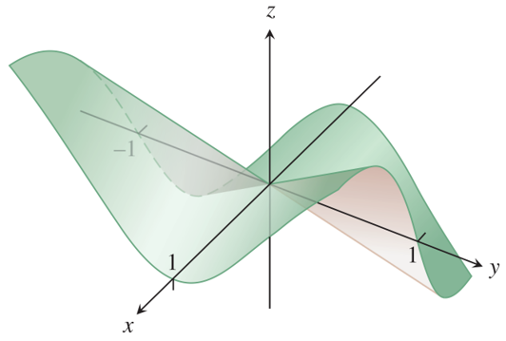
Limits for Functions of Two Variables (7 of 10)
The surface graph shows the limit of the function must be 0, if it exists.

Slide 32
Limits for Functions of Two Variables (8 of 10)
Example: Find
if it exists.
Solution: We first observe that along the line x = 0, the
function always has value 0 when
Likewise, along
the line y = 0, the function has value 0 provided
So if the limit does exist as (x, y) approaches (0, 0), the value of the limit must be 0.
Let
be given, but arbitrary. We want to find a
such that

Slide 33
Limits for Functions of Two Variables (9 of 10)
Solution (continued):
or
Since
we have that

Slide 34
Limits for Functions of Two Variables (10 of 10)
Solution (concluded):
So if we choose
and let
we get
It follows from the definition that

Slide 35
Continuity (1 of 10)
Definition: A function
is continuous at the point
if
1. f is defined at
2.
exists,
3.
A function is continuous if it is continuous at every point of its domain.

Slide 36
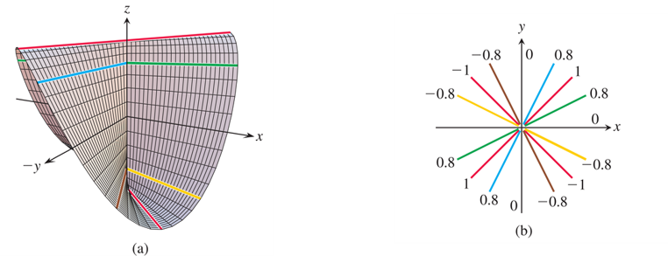
Continuity (2 of 10)
(a) The graph of
The function is continuous at every point except the origin. (b) The values of f are different constants along each line
Notes:
The computer generated graph, a, depicts a curve on an x y z plane. The curve has a crest at both the second and fourth octants and a trough at both the fifth and seventh octants. The two dimensional graph, b, depicts three lines with labels, in each quadrant. The lines start from the origin. The three lines in the first quadrant are labeled, 0.8, 1, and 0.8. The three lines in the second quadrant are labeled, negative 0.8, negative 1, and negative 0.8. The three lines in the third quadrant are labeled, 0.8, 1, and 0.8. The three lines in the fourth quadrant are labeled, negative 0.8, negative 1, and negative 0.8.

Slide 37
Continuity (3 of 10)
Example: Show that
is continuous at every point except the origin.
Solution: The function f is continuous at every point (x, y) except (0, 0) because its values at points other than (0, 0) are given by a rational function of x and y, and therefore at those points the limiting value is simply obtained by substituting the values of x and y into that rational expression.

Slide 38
Continuity (4 of 10)
Solution (continued):
At (0, 0), the value of f is defined, but f has no limit as
For every value of m, the function f has a constant value on
the “punctured” line
because
Therefore, f has this number as its limit as (x, y) approaches (0, 0) along the line:

Slide 39
Continuity (5 of 10)
Solution (concluded):
This limit changes with each value of the slope m. The limit fails to exist, and the function is not continuous at the origin.

Slide 40
Continuity (6 of 10)
Two-Path Test for Nonexistence of a Limit
If a function
has different limits along two
different paths in the domain of f as (x, y) approaches
then
does not exist.

Slide 41
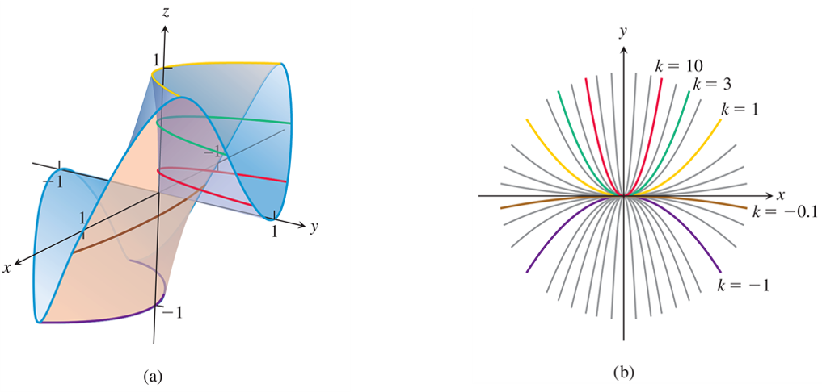
Continuity (7 of 10)
(a) The graph of
(b) Along each path
the value of f is constant, but varies with k.
Notes:
A computer generated graph, a, depicts a curve on an x y z plane. The irregular curve passes through x = 1, x = negative 1, y = 1, y = negative 1, z = 1, and z = negative 1. The two dimensional graph, b, depicts ten concave up curves starting from the origin, in each quadrant. Three curves in the first quadrant are labeled, k = 10, k = 3, and k = 1, respectively. Two concave down curves in the fourth quadrant are labeled, k = negative 0.1 and k = negative 1, respectively.

Slide 42
Continuity (8 of 10)
Example: Show that the function
has no limit as (x, y) approaches (0, 0).
Solution: We examine the values of f along parabolic
curves that end at (0, 0). Along the curve
the function has the constant value

Slide 43
Continuity (9 of 10)
Solution (concluded):
Therefore,
This limit varies with the path of approach. By the two-path test, f has no limit as (x, y) approaches (0, 0).

Slide 44
Continuity (10 of 10)
Continuity of Compositions
If f is continuous at
and g is a single-
variable function continuous at
then the composition
defined by
is continuous at

Slide 45
Functions of More Than Two Variables
The definitions of limit and continuity for functions of two variables and the conclusions about limits and continuity for sums, products, quotients, powers, and compositions all extend to functions of three or more variables.

Slide 46
Extreme Values of Continuous Functions on Closed, Bounded Sets
The Extreme Value Theorem states that a function of a single variable that is continuous at every point of a closed, bounded interval [a, b] takes on an absolute maximum value and an absolute minimum value at least once in [a, b]. The same holds true of
a function
that is continuous on a
closed, bounded set R in the plane (like a line segment, a disk, or a filled-in triangle).

Slide 47

Copyright
This work is protected by United States copyright laws and is provided solely for the use of instructors in teaching their courses and assessing student learning. Dissemination or sale of any part of this work (including on the World Wide Web) will destroy the integrity of the work and is not permitted. The work and materials from it should never be made available to students except by instructors using the accompanying text in their classes. All recipients of this work are expected to abide by these restrictions and to honor the intended pedagogical purposes and the needs of other instructors who rely on these materials.

